Slide 1

Predicting Credit Card Applications
Leon Felipe Galindo

Slide 2

In this presentation
Business proposition and research purpose.
Exploratory preview of the data.
Comparison between different models
Conclusions and possible next steps

Slide 3

Business proposition
In this project we have built a machine learning model in order to automate the credit card approval process.
The business application is of great value, with this model financial institutions can make more efficient the credit risk modeling process.
This type of models could also be applied to other business analysis , such as project finance and student loans applications.

Slide 4
Preview of the data
The data comes from UCI repository, it has a great mix of attributes -- continuous, nominal with small numbers of values, and nominal with larger numbers of values.
Column Name
Gender
Age
Debt
Married
Bank Customer
Education Level
Ethnicity
Column Name
Years Employed
Prior Default
Employed
Credit Score
Driver License
Citizen
Zip Code
Column Name
Income
Approved (Target)

Slide 5
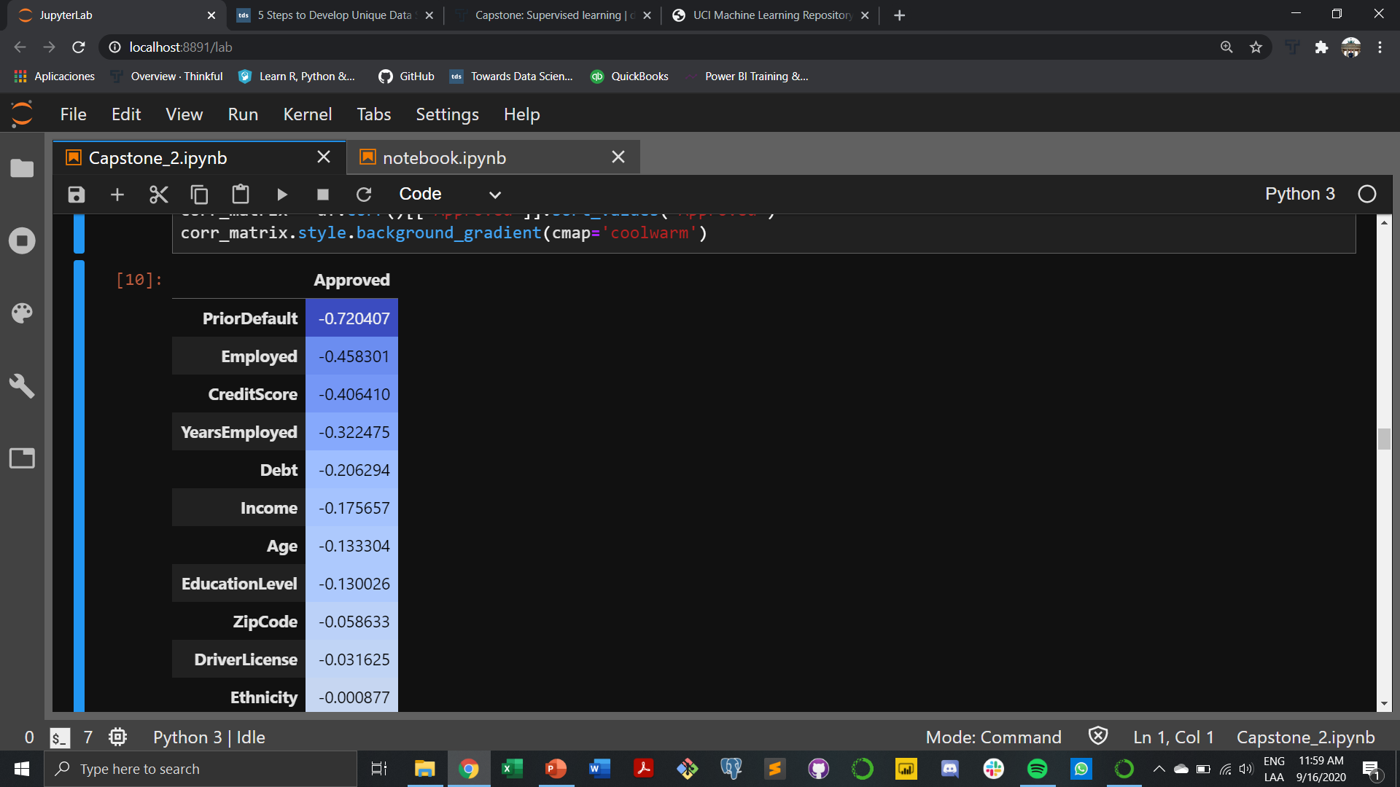
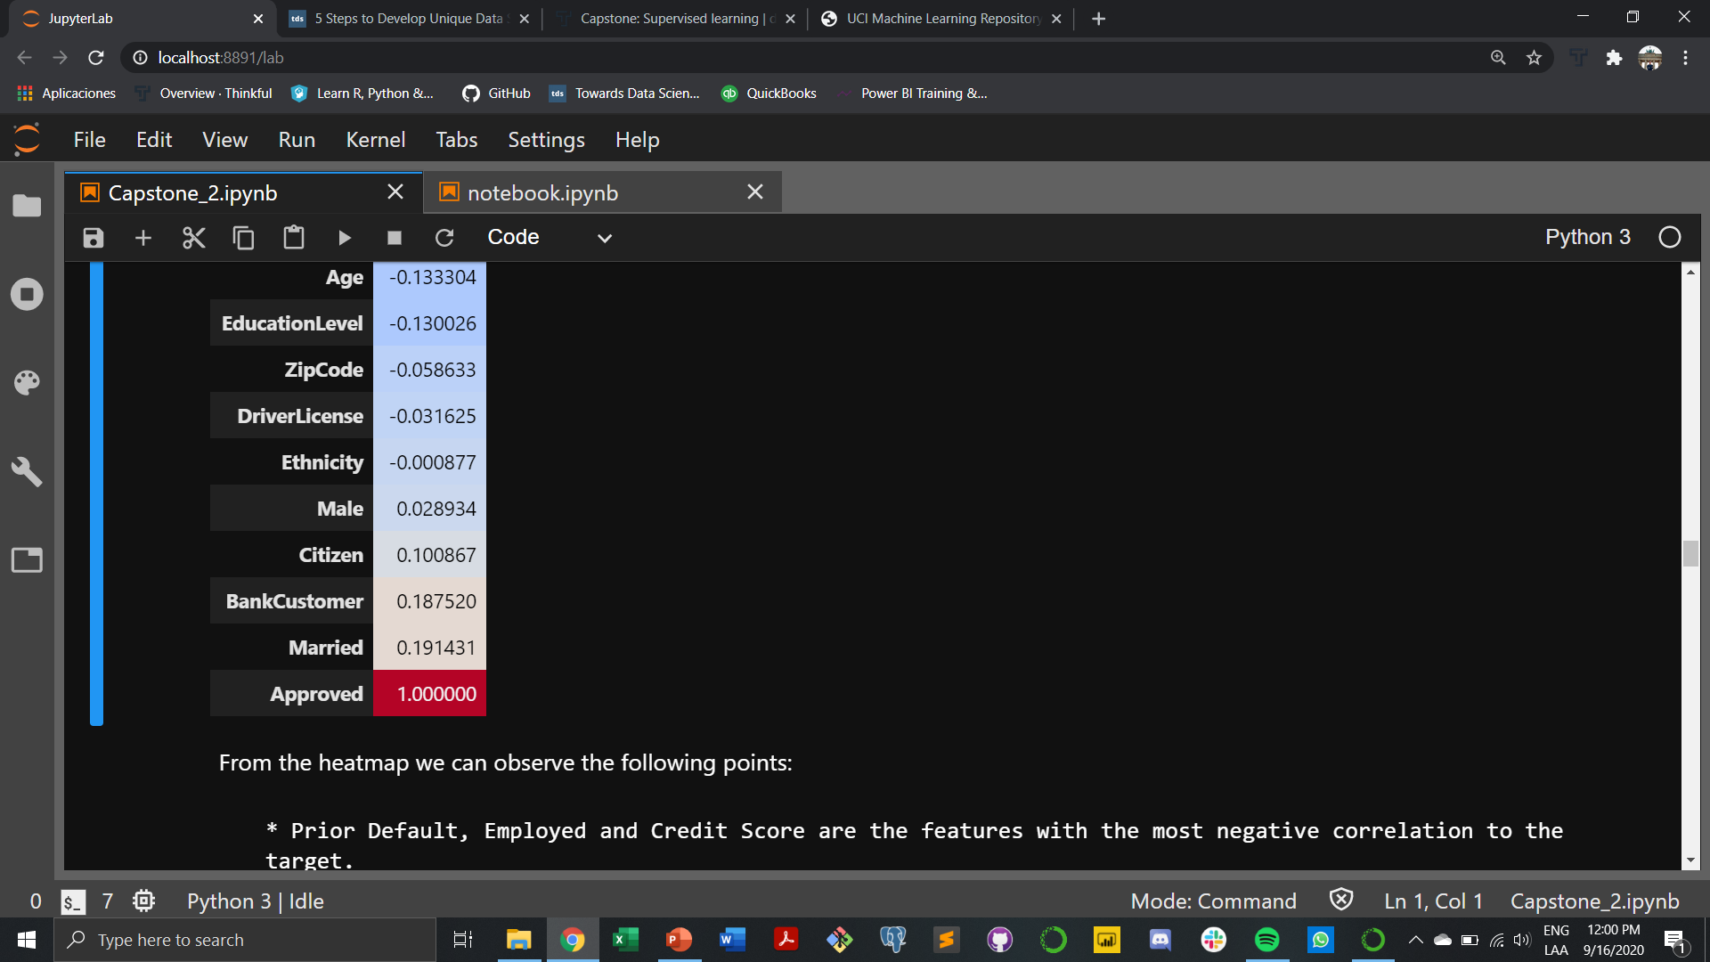
Analyzing correlation between features
Prior Default, Employed and Credit Score are the features with the most negative correlation to the target.
Married, Bank Customer and Citizen are the features with the most positive correlation with the target.
Zip Code and Drivers License don't have much predicting power.

Slide 6

Model building and analysis
For this classification research, we are going to perform the following models:
Logistic Regression
Random Forest
K-nearest Neighbors
XGB Classifier

Slide 7
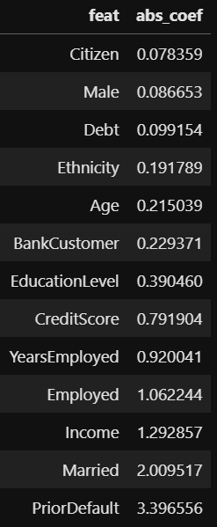
Logistic regression model
 | Predicted 0 | Predicted 1
Actual 0 | 72 | 10
Actual 1 | 16 | 75
The mean cross validation score is of 0.857
Prior default is by far the feature with the most predictive power, followed by married status and current income.
Train score: 0.868
Test score: 0.849

Slide 8
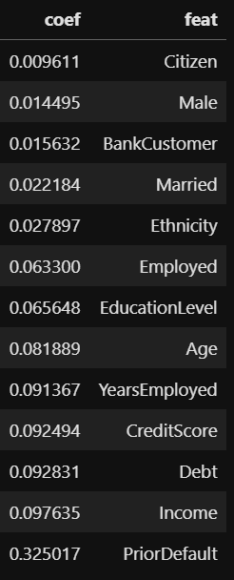
Random forest classifier
 | Predicted 0 | Predicted 1
Actual 0 | 65 | 17
Actual 1 | 9 | 82
The mean cross validation score is of 0.857
Prior default is also by far the feature with the most predictive power, followed by current income and current debt.
Train score: 0.868
Test score: 0.849

Slide 9
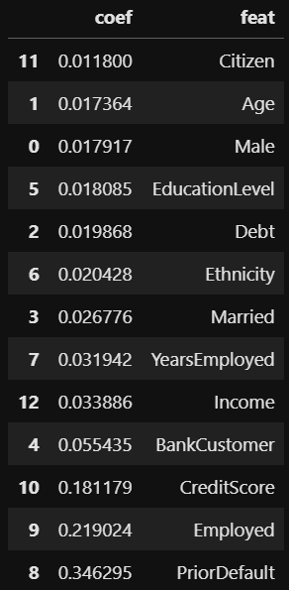
XGB Classifier
 | Predicted 0 | Predicted 1
Actual 0 | 67 | 15
Actual 1 | 11 | 80
The mean cross validation score is of 0.857
Prior default is also by far the feature with the most predictive power, followed by employed and credit score.
Train score: 0.949
Test score: 0.849

Slide 10
K-nearest neighbor
Train score: 0.882
Test score: 0.861
 | Predicted 0 | Predicted 1
Actual 0 | 68 | 14
Actual 1 | 10 | 81

Slide 11

Conclusions and possible next steps
We have explored which features are the most important predictors regarding credit card applications.
The models could also be applied to other types of credit decisions such as project finance and student loan applications.
This shows the great potential that machine learning models can have when making important business decisions.
The possible next step would be to adjust some of the hyperparameters in order to increase accuracy and reduce overfitting, specially with the XGB classifier.

Slide 12

Thank you

